Slide 1
INSURANCE ANALYTICS CAPSTONE PROJECT
Presented by Manasa k

Slide 2
Project Objective
Analyse insurance business performance.
Create Insurance Dashboard and Policy Dashboard.
Track KPIs effectively.
Enable data-driven decisions.
Improve operational efficiency.

Slide 3
Dataset Overview
Policy Data
Customer Data
Claims Data
Invoice Data
Opportunity Data
Meeting Data

Slide 4
Project Summary
Developed two dashboards:
Insurance Dashboard
Policy Dashboard
Used Excel, Tableau, and Power BI.
Built interactive visualisations.
Generated business insights through KPIs.

Slide 5
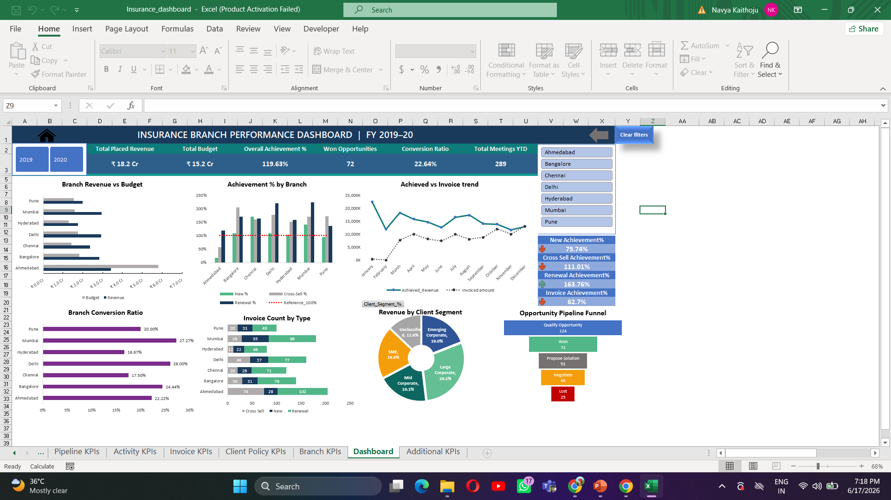
Excel Insurance Dashboard

Slide 6
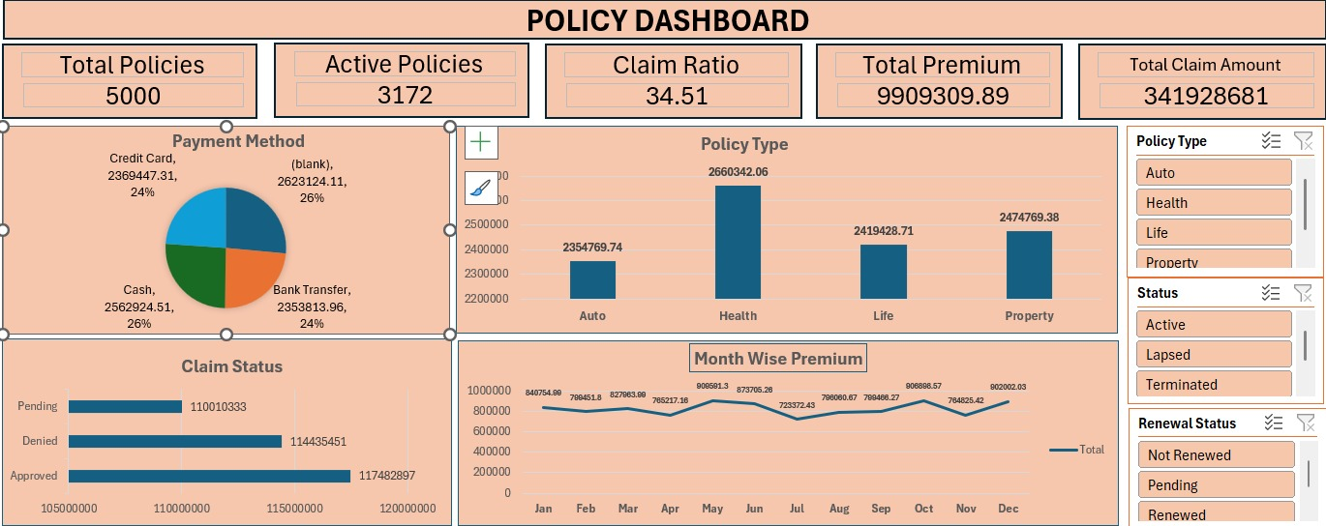
Excel Policy Dashboard

Slide 7
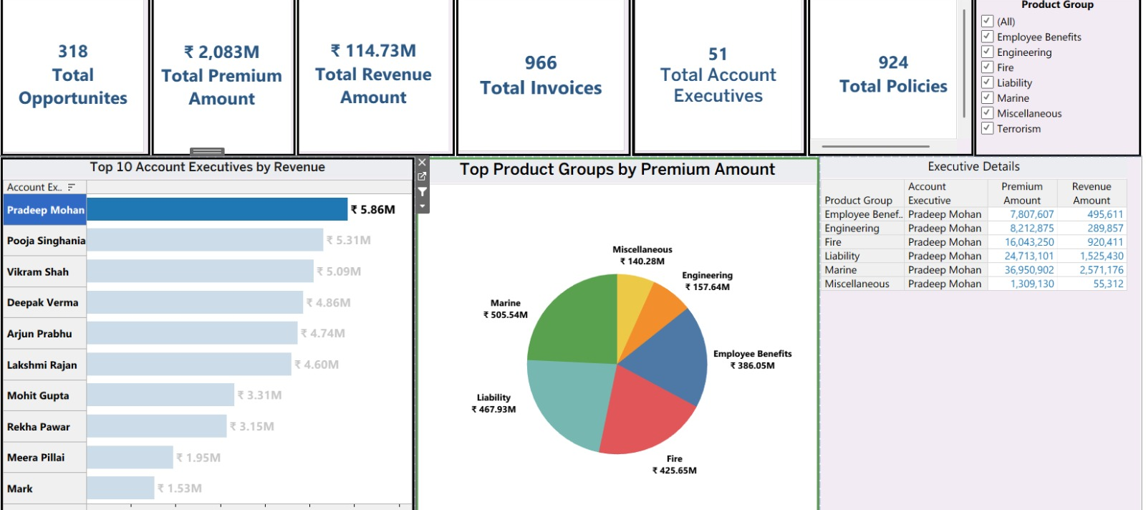
Tableau Insurance Dashboard

Slide 8
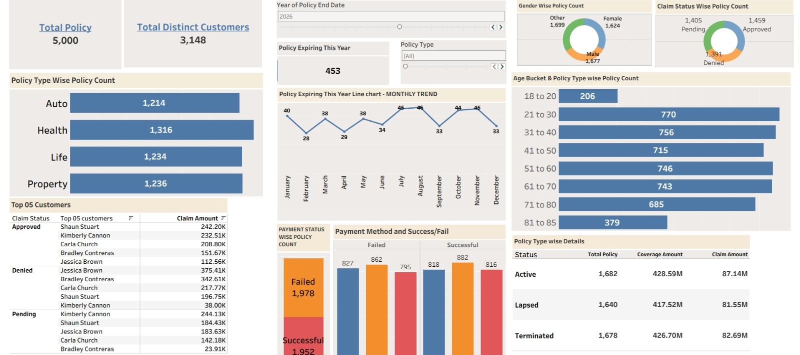
Tableau Policy Dashboard

Slide 9
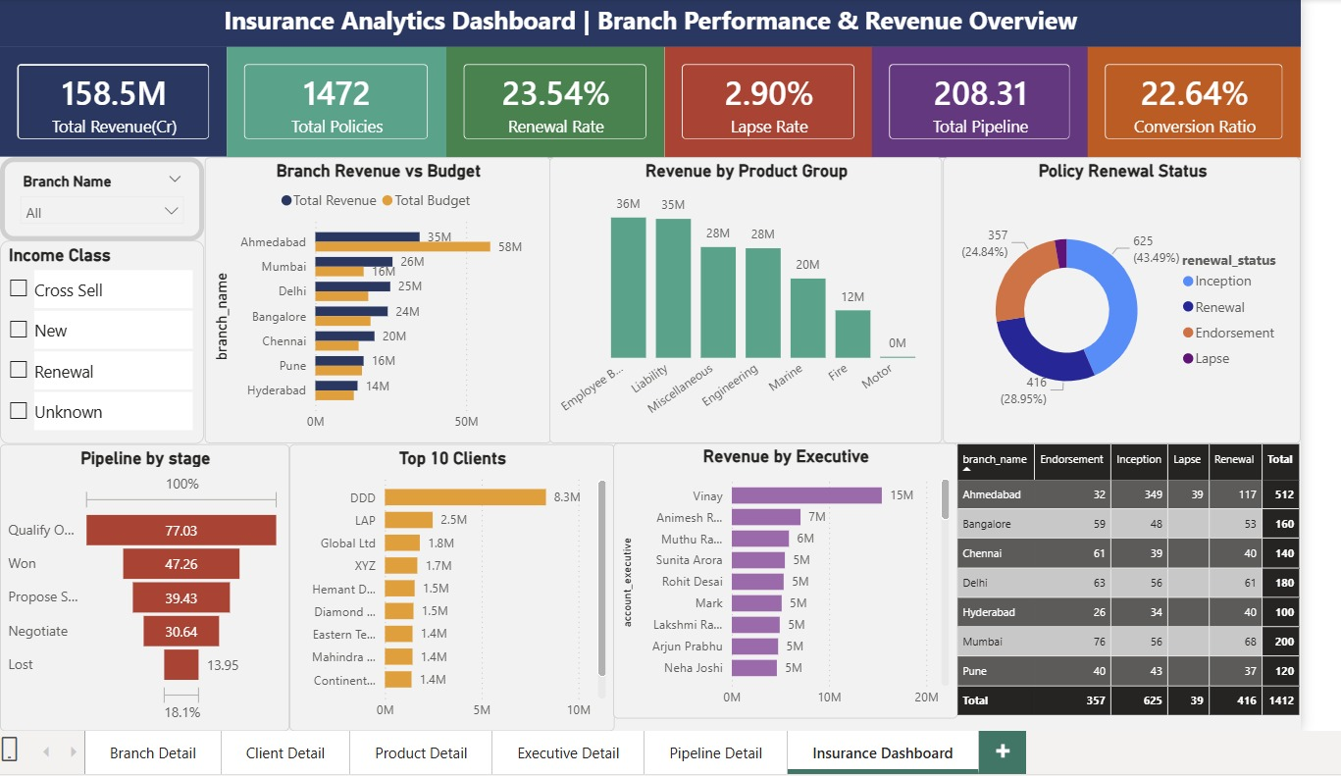
Power BI Insurance Dashboard

Slide 10
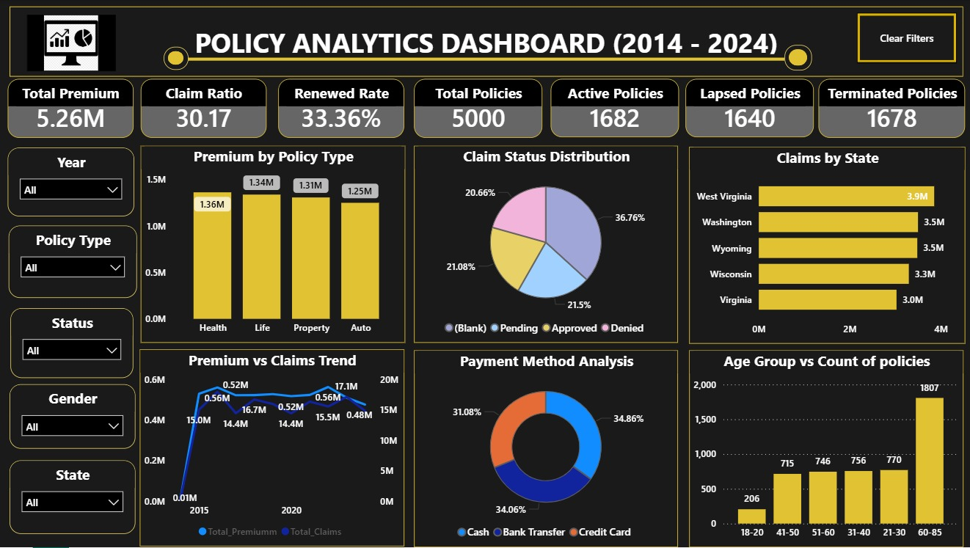
Power BI Policy Dashboard

Slide 11
KPI Categories
Insurance Dashboard
Performance KPIs
Pipeline KPIs
Activity KPIs
Invoice KPIs
Client & Policy KPIs
Branch KPIs
Policy Dashboard
Policy Metrics
Customer Metrics
Premium Metrics
Claims Metrics
Payment Metrics

Slide 12
Key Business Insights
Top Performing Branch
Highest Revenue Category
Best Conversion Rate
Claim Trends
Customer Distribution

Slide 13
Challenges Faced
Data Cleaning Issues
Missing Values
Data Integration Challenges
Dashboard Design Complexity

Slide 14
Recommendations
Improve Claim Processing
Focus on High Revenue Segments
Increase Customer Retention
Monitor KPIs Regularly

Slide 15
Conclusion
Successfully built Insurance and Policy Dashboards.
Generated meaningful business insights.
Improved visibility into insurance performance.
Supports strategic decision-making.

Slide 16
Thank You

